Slide 1



APP SERVICE
.

Slide 2

What is App Service?
App Service is a Platform as a Service (PaaS) offering from Microsoft. We use it to host web applications, REST API's and backend services for mobile applications.
It doesn't really matter which programming language or framework you have used. Web applications and services that are developed using any of the following programming languages or frameworks can be hosted using azure app service. It could be
.NET
.NET Core
Java
Ruby
Node.js
PHP
Python

Slide 3
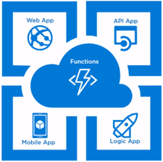
TYPES OF APP SERVICES:
1. Web App
It allows us to deploy our web application without having to worry about the necessary infrastructure. In the traditional deployment method, we must configure the server with the right OS and IIS versions and monitor if the server is up and operating.
2. API App
It aids in the deployment of Web APIs. ASP.net Web API or the equivalent in other languages can be used to design and deploy APIs. You can use this API both internally and externally (for example, through an API request from Logic Apps). To secure the APIs, it provides identification. It includes a swagger implementation that allows us to test APIs.
3. Logic App
By orchestrating work and business processes, it assists us in creating functional workflows. It streamlines the process of designing and developing scalable integration solutions. We can also handle massive workflows with it.
4. Mobile App
It helps us to construct mobile application backends. Modern mobile apps may run on Android, iOS, or UWP, and in the background, the app will request any type of transaction from the back-end. It is similar to online services that support a mobile client. This service offers nearly all of the features that Web Apps do. It also has capabilities like as offline synchronization and pushes notifications.

Slide 4
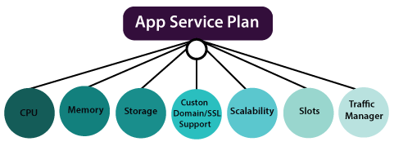
Azure App Service plan:
An app service plan denotes a set of features and capacity that we can share across multiple apps in the same subscription and geographical region. A single or dual app can be configured to run on the same computing resources.

Slide 5
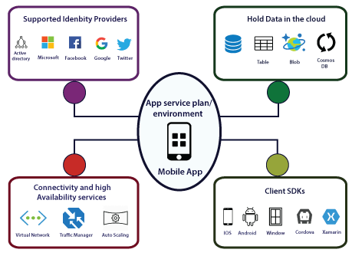
Azure Mobile App
We can deploy our mobile backend services on Azure using Azure Mobile apps. By implementing our mobile backend service on Azure, our mobile backend will be able to communicate with different Azure services. We can able to take advantage of various features that are provided by Azure Mobile Apps.

Slide 6
Why use App Service?
Azure App Service is a fully managed platform as a service (PaaS) offering for developers. Here are some key features of App Service:
Multiple languages and frameworks - App Service has first-class support for ASP.NET, ASP.NET Core, Java, Ruby, Node.js, PHP, or Python.
Managed production environment - App Service automatically patches and maintains the OS and language frameworks for you. Spend time writing great apps and let Azure worry about the platform.
Containerization and Docker - Dockerize your app and host a custom Windows or Linux container in App Service.
DevOps optimization - Set up continuous integration and deployment with Azure DevOps, GitHub, BitBucket, Docker Hub, or Azure Container Registry.

Slide 7
Why use App Service?
Global scale with high availability - Scale up or out manually or automatically. Host your apps anywhere in Microsoft's global data center infrastructure, and the App Service SLA promises high availability.
Connections to SaaS platforms and on-premises data - Choose from many hundreds of connectors for enterprise systems (such as SAP), SaaS services (such as Salesforce), and internet services (such as Facebook).
Security and compliance - App Service is ISO, SOC, and PCI compliant. Authenticate users with Azure Active Directory, Google, Facebook, Twitter, or Microsoft account.
Application templates - Choose from an extensive list of application templates in the Azure Marketplace, such as WordPress, Joomla, and Drupal.

Slide 8
App Service Environment overview
An App Service Environment is an Azure App Service feature that provides a fully isolated and dedicated environment for running App Service apps securely at high scale.
An App Service Environment can host your:
Windows web apps
Linux web apps
Docker containers (Windows and Linux)
Functions
Logic apps (Standard)

Slide 9
--------------------------------------------------
App Service Environments are appropriate for application workloads that require:
High scale.
Isolation and secure network access.
High memory utilization.
High requests per second (RPS). You can create multiple App Service Environments in a single Azure region or across multiple Azure regions. This flexibility makes an App Service Environment ideal for horizontally scaling stateless applications with a high RPS requirement.

Slide 10
Benefits of using azure app service
Fully managed environment
Multiple programming languages and frameworks are supported
Scalability
Compliance
Security
DevOps optimization
Access on-premises data

Slide 11
Azure App Service Backup
The App service backup and scaling is much simpler than virtual machine backup and scaling. The backup and restore in-app feature service let us quickly create app backups. This backup of app service will contain app configuration also, the file content, and optionally the database connected to our app. We can take backup along with the app service. The App service will have the following backup information:
App configuration
File content
Database connected to our app
There are several ways we can take backup:
Manually
Automation based on scheduling
Partial backup

Slide 12
Azure App Service Limitations:
The Shared pricing tier does not support App Service on Linux.
Only features that presently support Linux apps are displayed in the Azure interface. Features are activated on the portal as they are enabled.
Your code and content are given a storage volume for web content when pushed to built-in images, which Azure Storage supports. Compared to the container filesystem’s latency, this volume’s disc latency is higher and more changeable. The custom container option, which stores files in the container filesystem rather than on the content volume, may be advantageous for apps that frequently need read-only access to content files.
You have very little access to infrastructure because App Services is a component of the PaaS (Platform as a Service) concept. Therefore, checking log files or looking at IIS settings and event logs won’t help troubleshoot application issues.
You are unable to handle the server. Hence we are unable to set up any monitoring or administration software for third-party applications.
You are unable to monitor performance indicators like IIS queues because you don’t have access to the app server.

Slide 13
Conclusion:
Azure App Service is a Microsoft Azure PaaS (Platform as a Service) that can be used to develop and deploy applications on Azure. Many features are included, such as auto-scaling, IDE integration, and no server upkeep. Multiple deployment slots, such as staging and production, are also available.

Slide 14


